Slide 1
Limited dependent Variable models (LDV)
Murthi

Slide 2
What is LDV?
LDV means that there is a limit on the dependent variable, e.g.,
Quantity purchased – 0 for those who did not purchase but positive for others.
Wages = 0 for unemployed but positive for others.
Demand for Mavs tickets is limited at hall capacity, say 23,000.
Income is not recorded above $100,000.

Slide 3
Censoring and truncation
Censoring is when limit observations are in the sample. Sample is representative of the population but the mean is not.
Sample includes consumers who did not buy
Truncation is when limit observations are not in sample. This sample is not representative of the population.
Sample has consumers with only positive quantities.

Slide 4
Censoring
Censoring from below
Y = y*, if y* > L
= L, if y* <= L
Censoring from above
Y = y*, if y* < U
= U, if y* >= U

Slide 5
Left- and right-censoring in the data
left-censored
right-censored
Distribution of hourly benefits, Fringe.dta,
Distribution of log-wages in German male clerks

Slide 6
Truncation
Y=y*, if y* > L
OR
Y=y*, if y* < U

Slide 7
Example: Bias in censored models
Regression with simulated data
x_{i} and ε are drawn from N(0,1)
y_{i} = α + x_{i} β + ε_{i}
Let α=0 and β=1 (45º line) and construct y
Estimate y_{i} = α + x_{i} β + ε_{i}

Slide 8
Effect of running OLS
Consider three LHS variables
y₁ is as reported (no censoring)
y₂=min(1,y₁)
censored 23.9%
y₃=min(0.25,y₁)
Censored 41.8% of the time

Slide 12
OLS Estimate of α and β
 | Dependent Variable |  |  | Ratio, β_{Yj}/ β_{Y1}
 | Y₁ | Y₂ | Y₃
α | 0.027 | -0.189 | -0.432
β | 1.023 | 0.755 | 0.565 | 0.738 | 0.553
% cen. (1-%cen) | 0 | 0.239 0.761 | 0.418 0.582

Slide 13
Comparison of estimates
 | OLS using Y1 | Tobit using Y2 | Tobit using Y3
α | 0.027 (0.031) | 0.0133 (0.033) | -0.0001 (0.004)
β | 1.0229 (0.027) | 1.0078 (0.036) | 0.9960 (0.041)
OLS on complete sample is biased and inconsistent
OLS on only positive values is also biased and inconsistent

Slide 14
One solution
Estimate a logit/probit model
But we are losing information on y
Right solution
Run Tobit (Tobin’s probit 1958)

Slide 15
Tobit model
Censored Normal regression model
Y^{* =} xβ + e
Y= y*, if y* > 0
0, if y* <= 0
The dep. var. is y = max(y*, 0)
Tobit model is a combination of two models
Probit model for whether y is 0 or not
Prob(y>0) = Φ(x’β)
Censored regression
E(Y|y>0) = x’β + σλ(x’β/σ)

Slide 16
SAS: PROC QLIM
TOBIT model
PROC QLIM data=a1 type=tobit;
model Y = x1 x2 x3;
endogeneous censored=(lb=l1 ub=l2 y);
Run;
TRUNCATED REGRESSION model
PROC QLIM data=a1 type=tobit;
model Y = x1 x2 x3;
endogeneous truncated=(lb=l1 ub=l2 y);
Run;

Slide 17
QLIM
Model fit Summary
Number of Endogenous Variables | 1
Endogenous Variable | Hours
Number of Observations | 17
Log Likelihood | -74.93700
Maximum Absolute Gradient | 1.18953E-6
Number of Iterations | 23
Optimization Method | Quasi-Newton
AIC | 157.87400
Schwarz Criterion | 161.20685
Model fit
Use AIC, SC, LogL

Slide 18
proc qlim data=subset; model hours = yrs_ed yrs_exp; endogenous hours ~ censored(lb=0); run;
Parameter | Estimate | Standard Error | t Value | Approx Pr > |t|
Intercept | -5598.29 | 27.69 | -202.16 | <.0001
Yrs_Ed | 373.12 | 53.98 | 6.91 | <.0001
Yrs_Exp | 63.33 | 36.55 | 1.73 | 0.0831
_Sigma | 1582.85 | 390.07 | 4.06 | <.0001
More education => more hours
P-value not sig. at 95%
Estimate of error variance

Slide 19
Selection model
If the occurrence of zero values are random across the population, then tobit model is correct.
If they are not random then we need to use selection models. In effect we assume that a certain kind of person chooses to participate while others do not. Use selection model.

Slide 20
Two types of selection
Other selection – admin decides who gets special coaching/tutoring in school in math. Selection is based on performance in math.
Self selection - If choice of participation (0/1) is not random but is based on factors that also effect wages then we have a selection problem.
If unobservables in the selection rule also appear in the model of interest (or are correlated with unobservables in the model of interest) and this is ignored, then it leads to Selection Bias.

Slide 21
Selection model proc qlim data=mroz; model inlf = nwifeinc educ exper expersq age kidslt6 kidsge6 /discrete; model lwage = educ exper expersq / select(inlf=1); run;
Number of Endogenous Variables | 2
Endogenous Variable | inlf lwage
Number of Observations | 753
Log Likelihood | -832.88509
Maximum Absolute Gradient | 0.00502
Number of Iterations | 78
Optimization Method | Quasi-Newton
AIC | 1694
Schwarz Criterion | 1759

Slide 22
Selection model
Parameter | Estimate | Standard Error | t Value | Approx Pr > |t|
lwage.Intercept | -0.552 | 0.26 | -2.12 | 0.0338
lwage.educ | 0.108 | 0.015 | 7.29 | <.0001
lwage.exper | 0.042 | 0.015 | 2.88 | 0.0040
lwage.expersq | -0.001 | 0.0004 | -2.01 | 0.0449
_Sigma.lwage | 0.663 | 0.0227 | 29.22 | <.0001
inlf.Intercept | 0.266 | 0.5089 | 0.52 | 0.6006
inlf.nwifeinc | -0.012 | 0.0048 | -2.49 | 0.0129
inlf.educ | 0.131 | 0.0253 | 5.17 | <.0001
inlf.exper | 0.123 | 0.0187 | 6.58 | <.0001
inlf.expersq | -0.002 | 0.0006 | -3.14 | 0.0017
inlf.age | -0.052 | 0.0084 | -6.23 | <.0001
inlf.kidslt6 | -0.867 | 0.1186 | -7.31 | <.0001
inlf.kidsge6 | 0.036 | 0.0434 | 0.83 | 0.4093
_Rho | 0.027 | 0.1470 | 0.18 | 0.8564

Slide 23
POISSON REGRESION
Modeling count data

Slide 24
Count data
Count data is a type of data in which the observations can take only the non-negative integer values {0, 1, 2, 3, ...}, and where these integers arise from counting rather than ranking.
Examples
The number of occurrences of thunderstorms in a calendar year
Number of purchases of toothpaste in a week
Number of heart patients per month
Number of defaults per month or year
Number of insurance claims per month

Slide 25
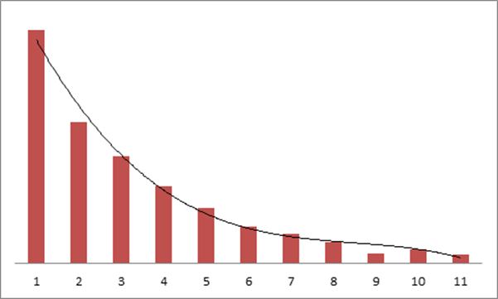
OLS is inappropriate because the distribution is Poisson, not normal
CRITICAL ASSUMPTION of Poisson: Mean = Variance

Slide 26
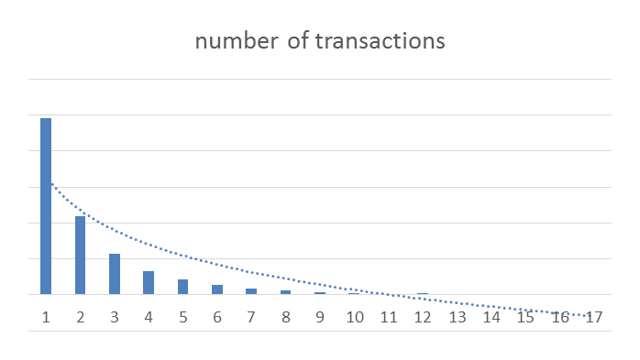
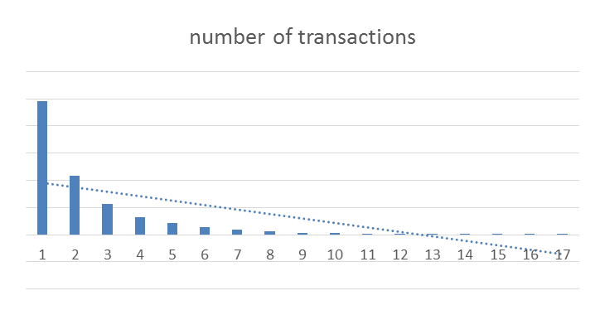
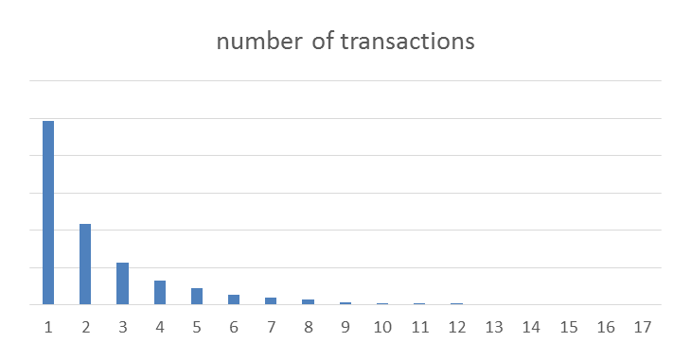
POISSON REGRESSION
POISSON regression is about modeling count data
Usually in such marketing data, there are a large number of 0s or 1s and then the distribution quickly decreases
KEY ASSUMPTION: the MEAN = VARIANCE
Applying OLS is a typical choice but look where the regression line is
The mean is 2.35
mean

Slide 27
Comparing OLS to Poisson regression
proc reg data = merge;
model total_txns = hhage hhkids cmpns tenure;
output out = regress p = predicted;
run;
proc countreg data=merge;
model total_txns = hhage hhkids cmpns tenure / dist=poisson ;
output out = poisson pred = predicted;
run;
proc corr data = regress;
var total_txns predicted; run;
proc corr data = poisson;
var total_txns predicted; run;
Two other ‘flavors’ of poison regression:
ZERO INFLATED
If too many zeros
NEGATIVE BINOMIAL
If over dispersed (variance is larger than means

Slide 28
Methods
Poisson regression – error term follows a Poisson distribution (note mean = variance for this distribution)
NBD: Negative Binomial regression (if variance is > 2*mean, use this distribution).
ZIP – Zero inflated Poisson – Model for too many zeros
SAS CODE: PROC COUNTREG

